Slide 1
Tutorial 4
Ziren
u4975835@anu.edu.au
Thursday 10 am to 11am
CBE 3.09

Slide 2
Multiple Linear Regression
μ{Y|X}=β₀+β₁X₁+···+β_{k}X_{k},
# whereX=(X₁,···,X_{k})
μ{Y|Z}=β₀+β₁Z+β₂Z²
# polynomial regression but still linear in terms of β
μ{Y|Z}=β₀+β₁Z^{β2} +β₃Z^{β4}
# Not a linear regression model as β is not linear
μ{Y |X1, X2} = β₀ + β₁X₁ + β₂X₂
#β₁ gives the increase in the mean of response for a unit increase in X₁, with X₂ held constant (Marginal effect: partial derivative)

Slide 3
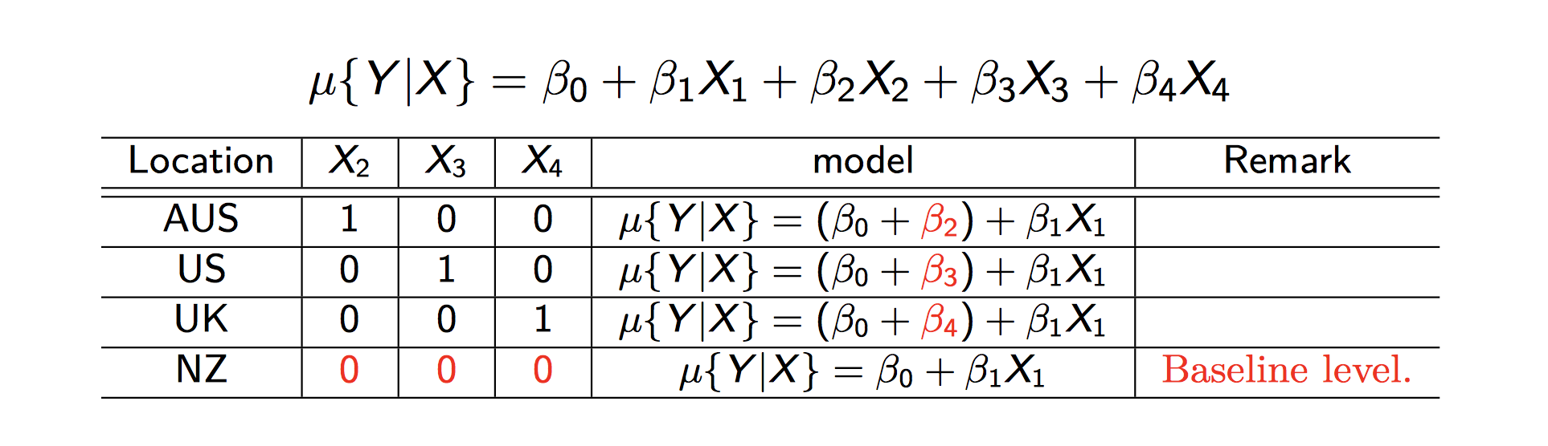
Indicator variable
Y=students’ reading ability; X₁=age
Do not use baseline indicator in the model
X₂+X₃+X₄+X₅=1

Slide 4
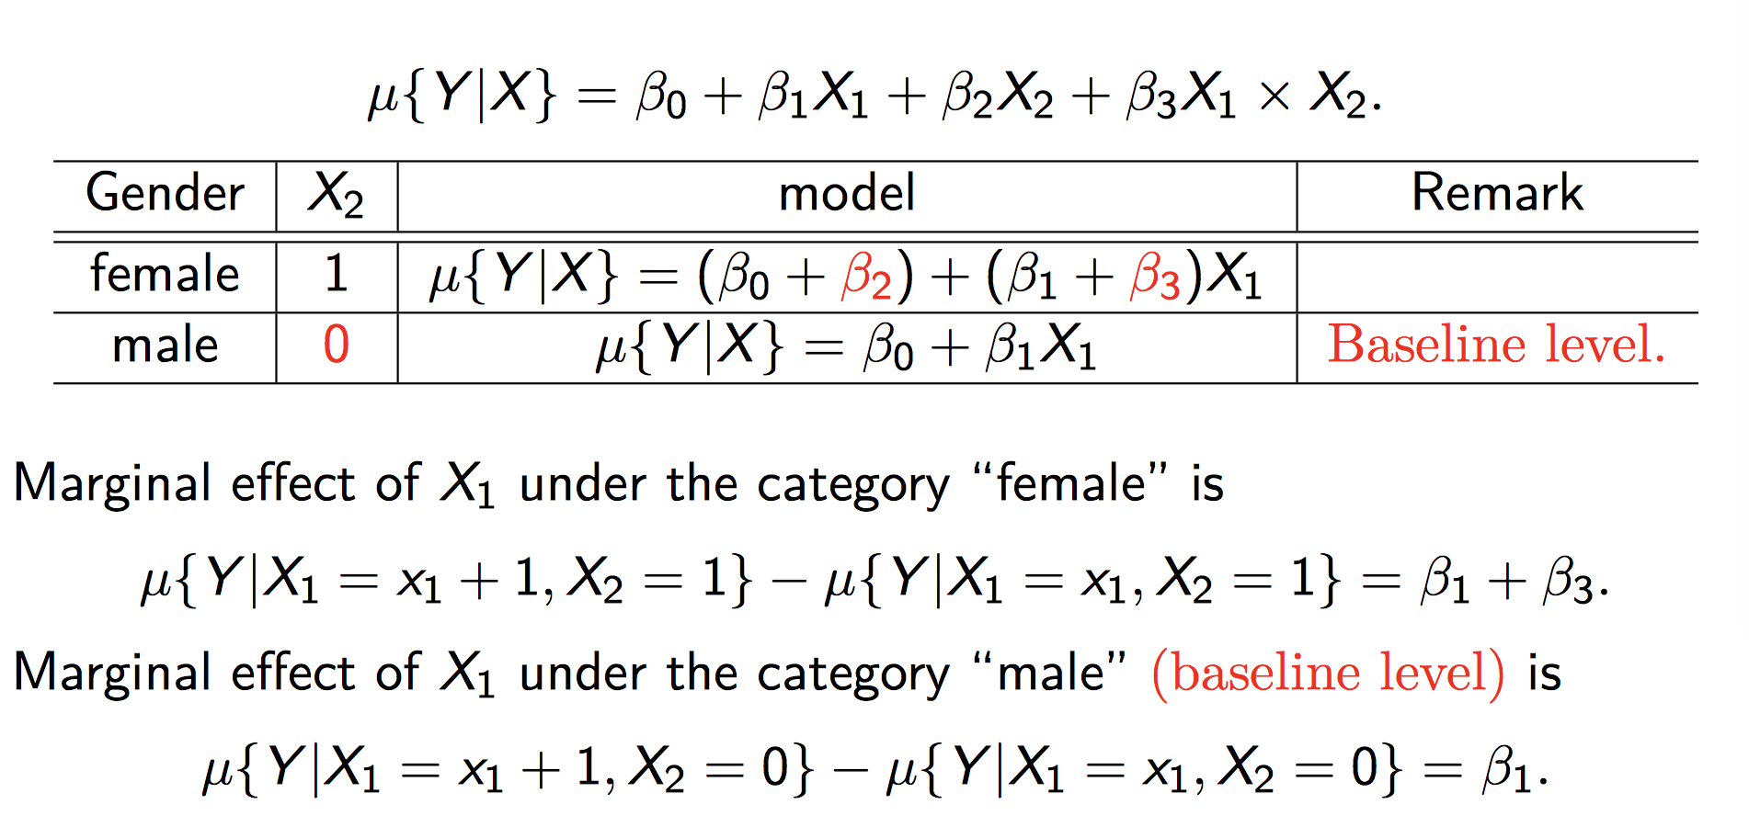
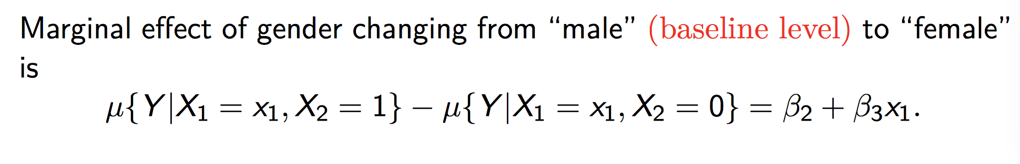
Interaction Term

Slide 5
Question 1
The data on corn yields and rainfall, discussed briefly in class, can be found in the file “corn.csv”. This file contains the corn yield (bu/acre), rainfall (in/year), and the corresponding year.
Plot corn yield versus rainfall.
Fit the multiple linear regression of corn yield on rain and rain².
Plot the residuals versus year. Is there pattern evident in this plot? What does it mean?
Fit the multiple regression of corn yield on rain, rain², and year. How do the coefficients of rain and rain² differ from those in the estimated model in (2)? How does the estimate of σ differ? How do the standard errors of the coefficients differ? Describe the effect of an increase of one inch of rainfall on the mean yield over the range of rainfalls and years.
Fit the multiple regression of corn yield on rain, rain2, year, and year rain. Is the coefficient of the interaction term significantly different from zero? Interpret the interaction term?

Slide 6
Question 2
The Kentucky Derby is a 1.25 mile horse race held annually at the Churchill Downs race track in Louisville, Kentucky. The file “derby.csv” contains the data on the year of the race, the winning horse, the conditions of the track, and the average speed (in feet per second) of the winner, for years 1896-2000. The track conditions have been grouped into three categories: fast, good, and, slow. Model the mean winning speed as a function of year and track conditions. (Hint: The first thing you should do is look at a plot of winning speed versus year. What does a curved plot suggest?)

Slide 7
Question 3
As part of a study of the effects of predatory intertidal crab species on snail populations, researchers measured the mean closing forces and the propodus heights of the claws on several crabs of three species. This data is contained in the file “crab.csv”.
Fit a regression model of log(force) on log(height) and species, allow for an interaction between log(height) and species. Let Hemigrapsus nududus be the baseline species, i.e., do not use an indicator variable for this species.
What is the p-value for the test of the hypothesis that whether the slope in the regression of log(force) on log(height) is the same for Lophopanopeus bellus as it is for Hemigrapsus nududus?

